Slide 1

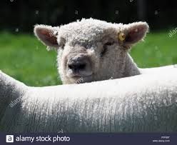
Challenges and opportunities facing the UK sheep industry - and the work of the National Sheep Association

Slide 2
NSA vision statement
A stable and resilient UK sheep population that is healthy and able to cope with disease and parasite challenges. Diverse in structure, contributing to feeding and providing fibre for an increasing global population, and working in harmony with areas of public interest including the environment and ecology, landscape, resource use, and culture and rural employment. Our vision is one of the people involved in keeping sheep being enthusiastic, knowledgeable, and aspiring to best practice, and those not keeping sheep increasingly aware of the contribution sheep make to society and of the core aspects of the sector.

Slide 3

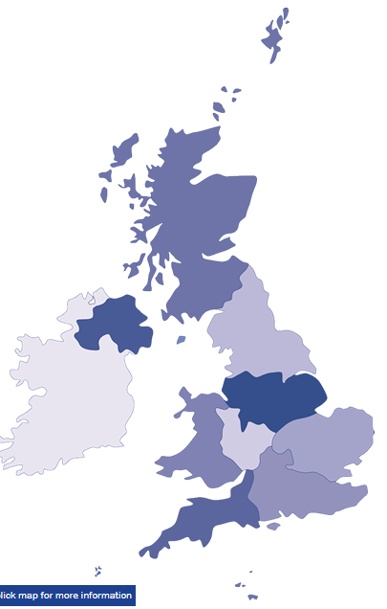
NSA today
NSA is a registered UK Charitable Company working as a membership organisation and funded by its membership.
We have 6,500 individual members +82 breed societies.
Aim to create a sustainable and prosperous sheep industry.
Supporting sheep farmers in many ways
Informing government and policy makers.
Raising awareness and understanding of the public.

Slide 4
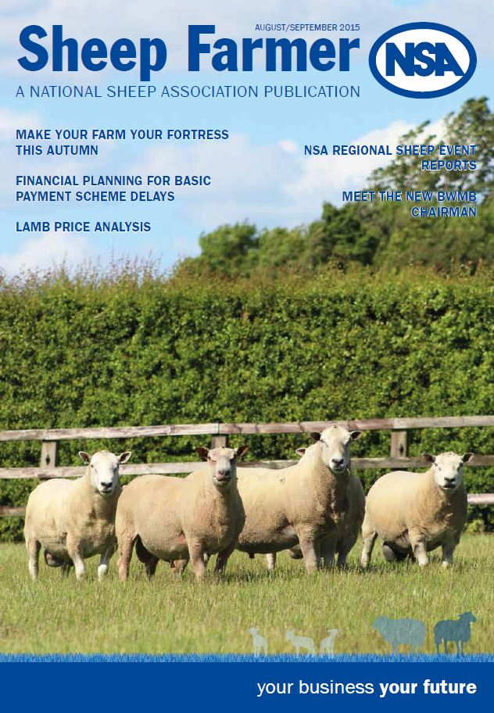
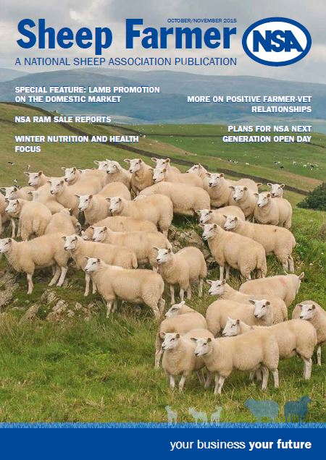
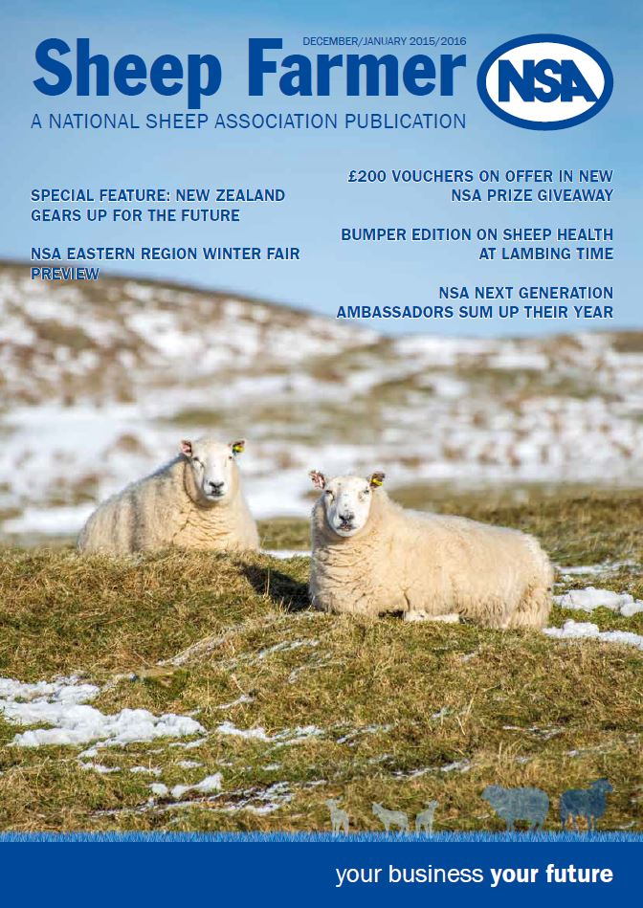
Sheep Farmer magazine

Slide 5

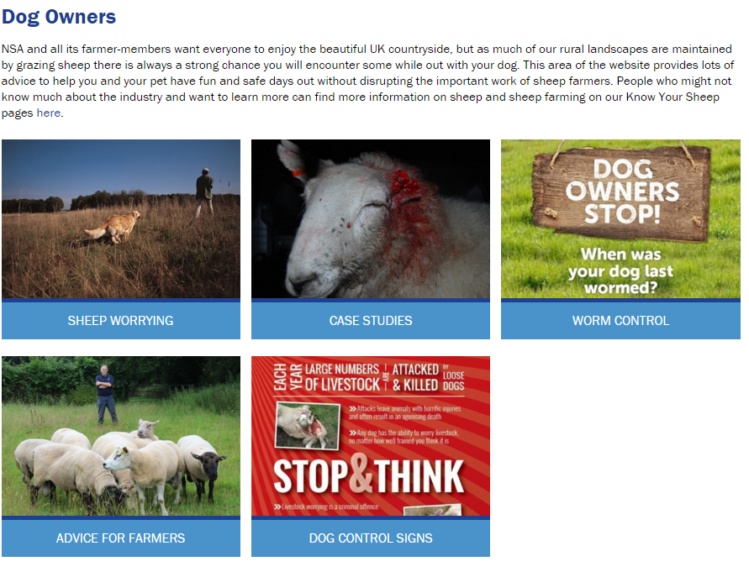
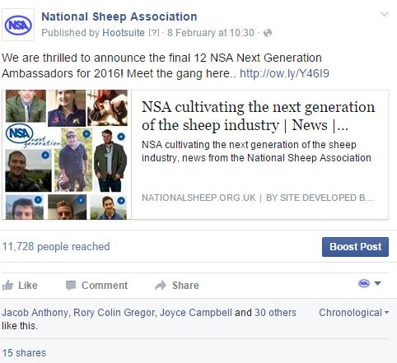
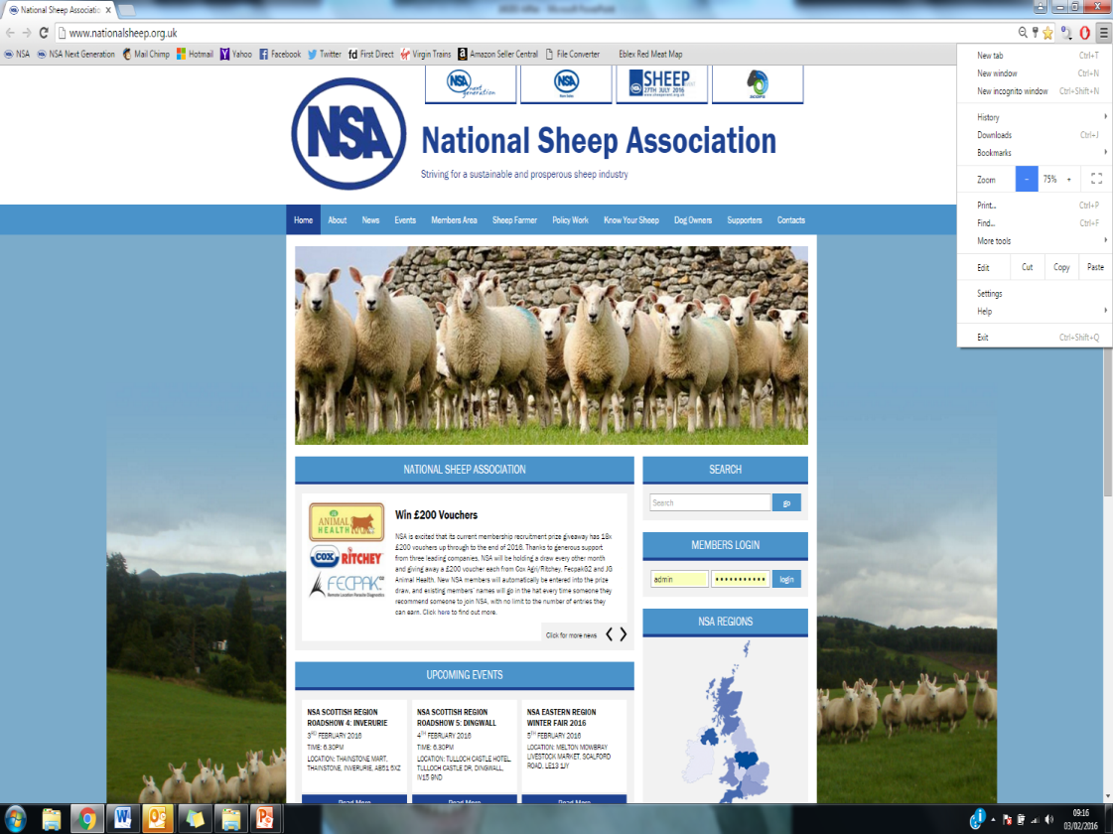
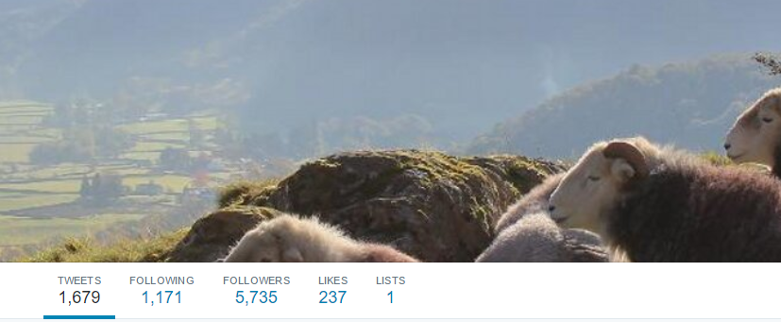
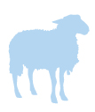
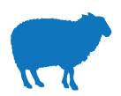

NSA online
The Sheep Centre, Malvern, Worcestershire, WR13 6PH, enquiries@nationalsheep.org.uk, www.nationalsheep.org.uk A company Limited by Guarantee. Registered in England. Registration No 37818. Registered charity in England and Wales (249255) and in Scotland (SC042853)
your business your future

Slide 6

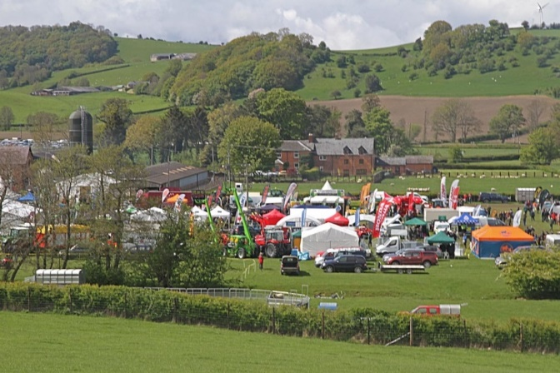
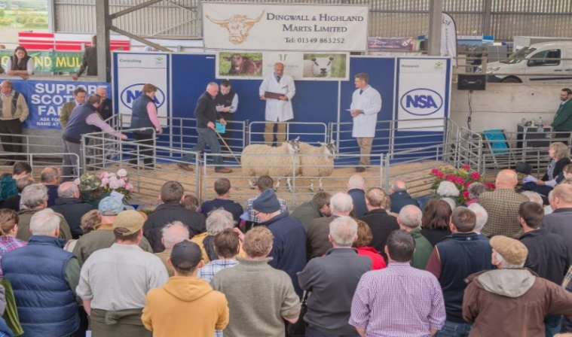
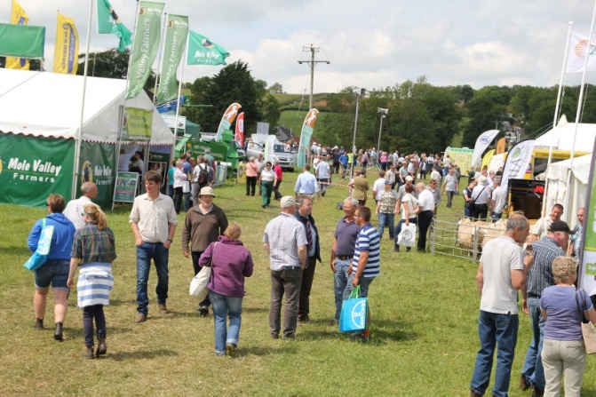
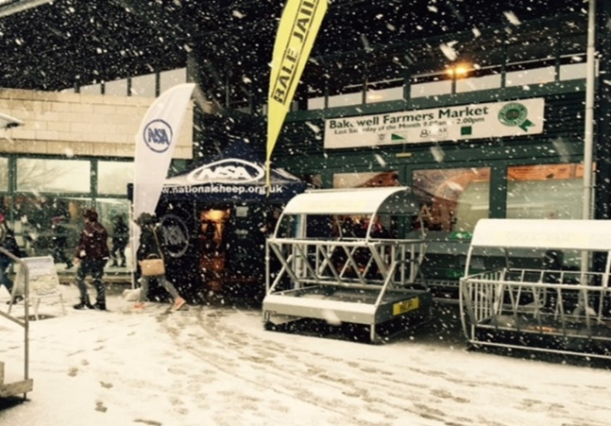
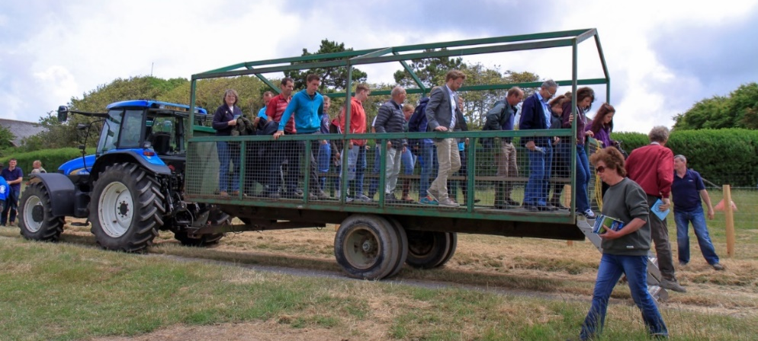
Sheep events

Slide 7
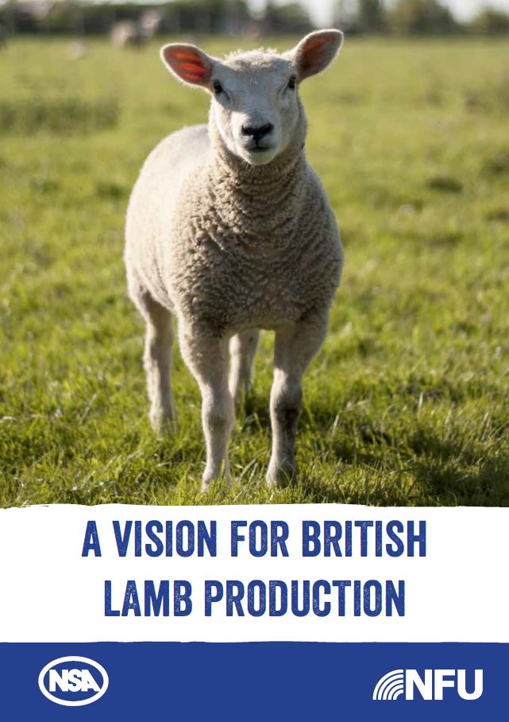
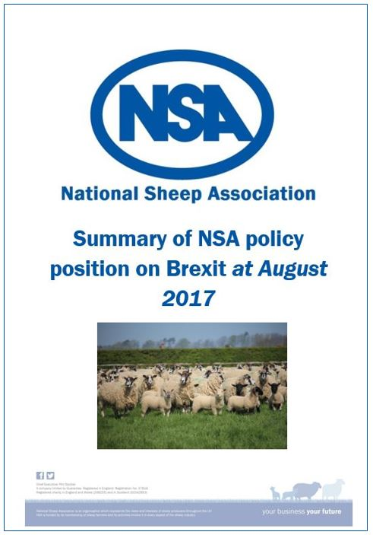
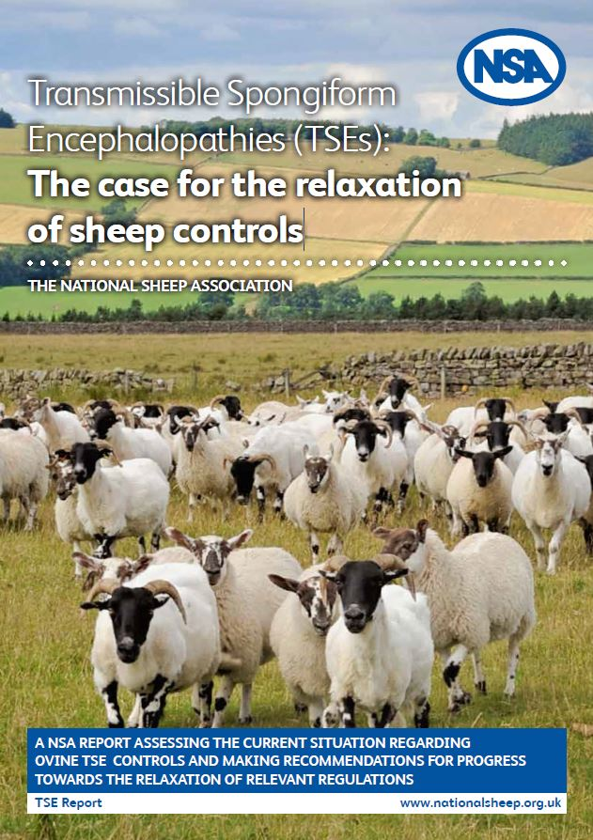
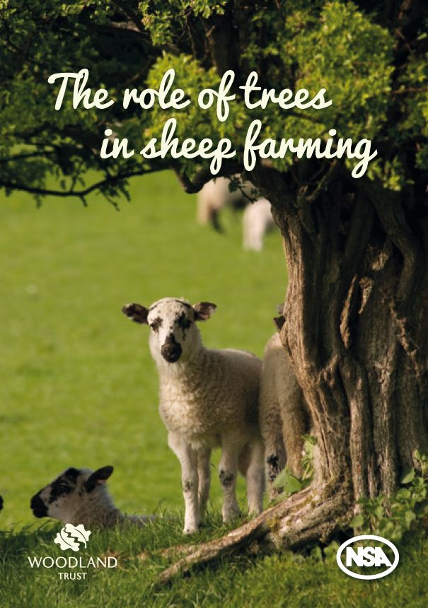
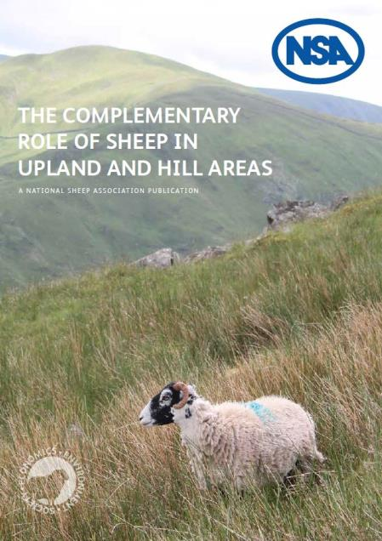

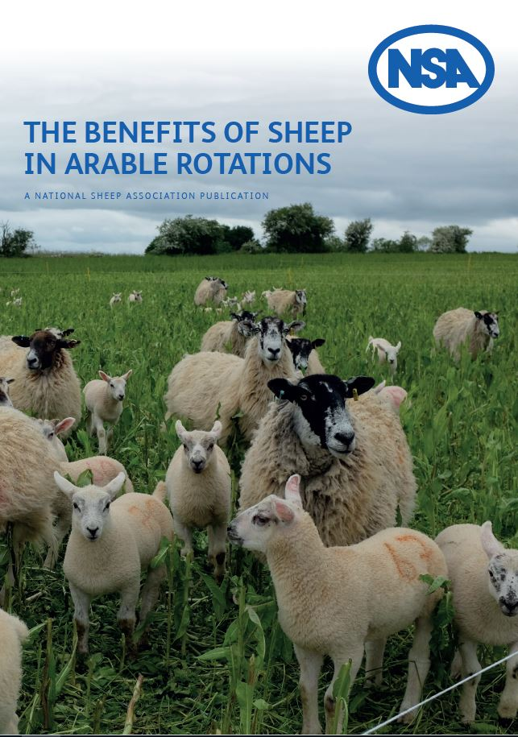
Available at www.nationalsheep.org.uk/policy-work

Slide 8

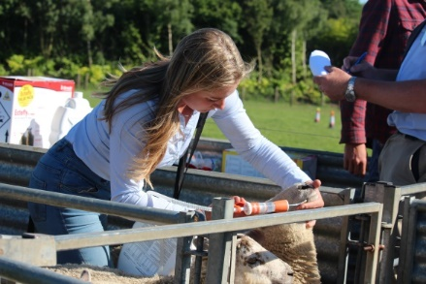
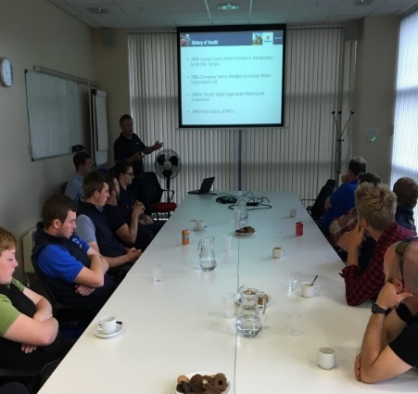
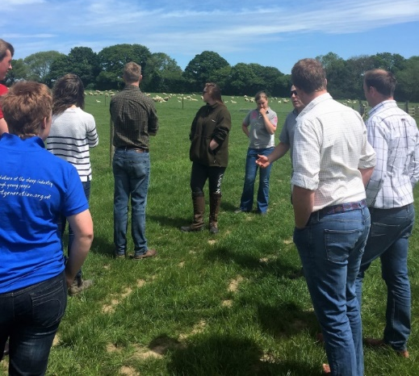
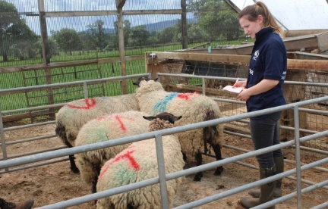
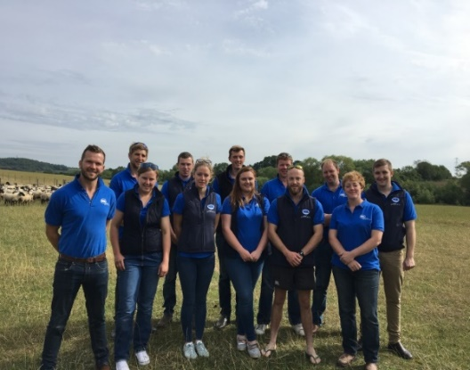
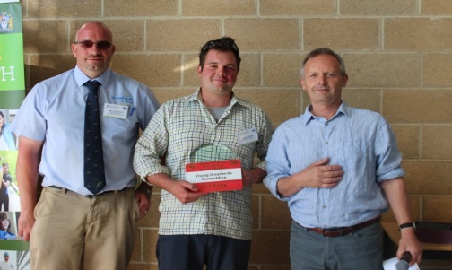
NSA Next Generation activity
Dedicated Next Generation website
Work experience placements and assistance for job seekers
Lambing List placements
Next Generation Shepherd competitions (National, European and international finals)
Annual Next Generation Day
Sponsorship from regions to attend events
Ambassador Groups – Biannual
Travel and study bursary

Slide 9

Sustainability assessments

Slide 10

Virtually every other food category has blossomed into offering a diversity of types

Slide 11

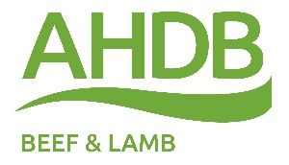


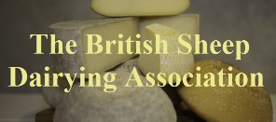



















Industry partnerships
Levy bodies - AHDB, HCC, QMS, LMC
British Wool, British Sheep dairy Assn
Unions – NFU and NFU Cymru, NFUS, UFU, FUW
Sector specific associations
UK Livestock Industry Brexit Group
Sheep Health and Welfare Group, RUMA, SCOPS, Traceability Design Users Group
Research bodies, SRUC, ORC, Rothamstead North Wyke, Agricultural universities, Uplands Alliance, Foundation for Common Land, Moredun

Slide 12
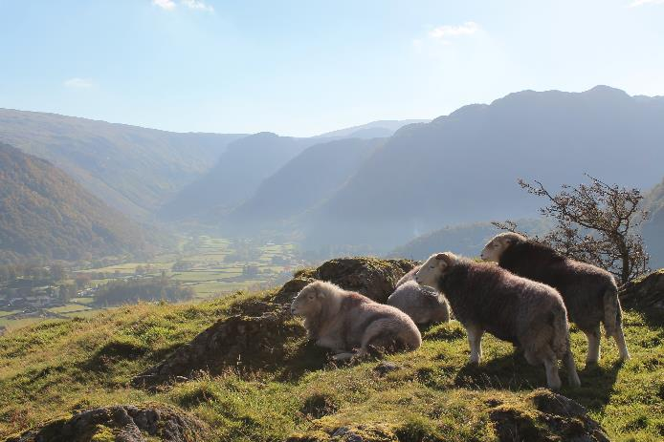
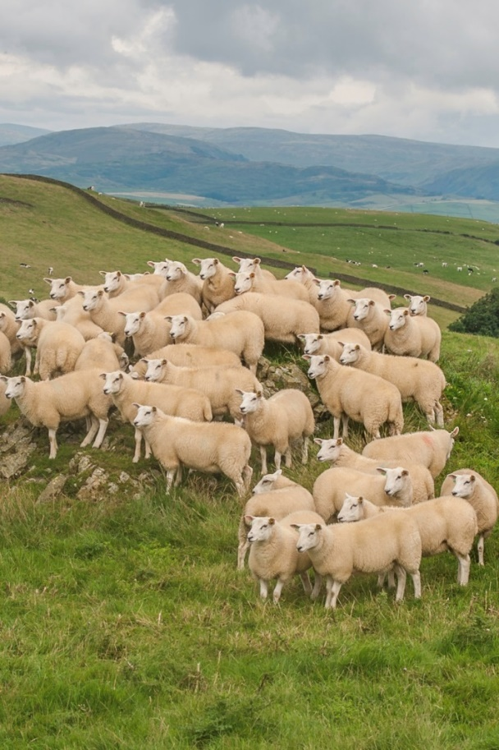
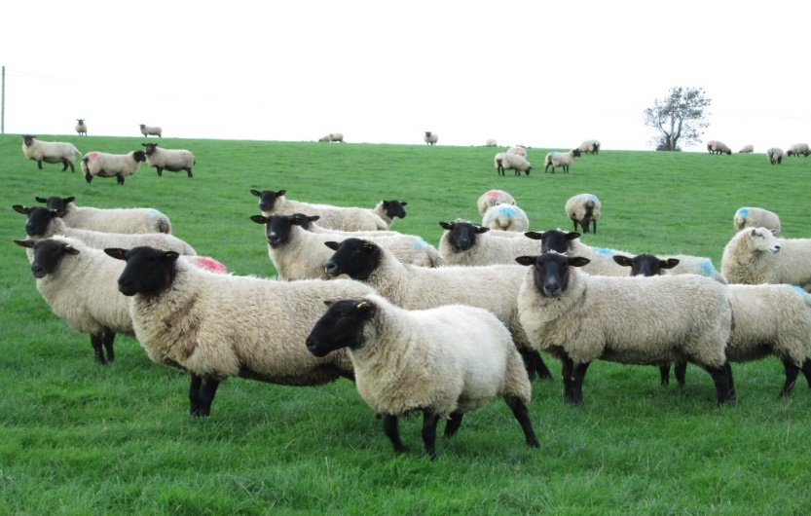
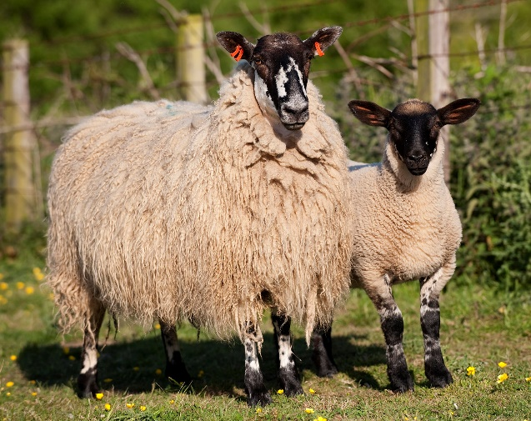
Mountains, upland, lowland
A diversity of breeds have different strengths, and are kept in different landscapes across the country.

Slide 13
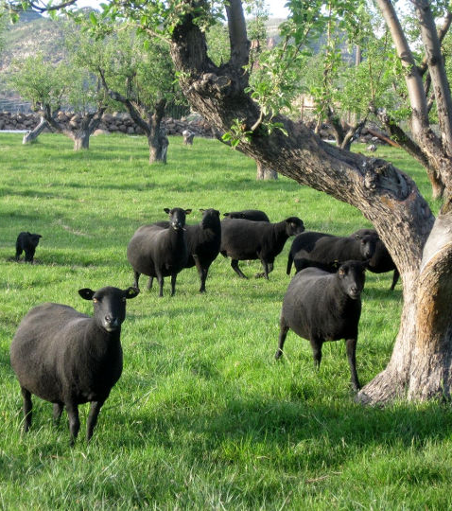
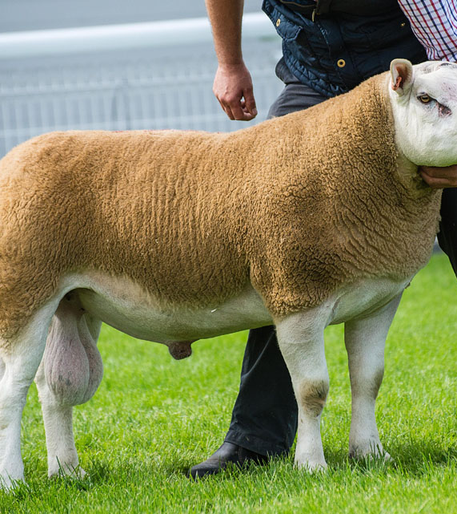


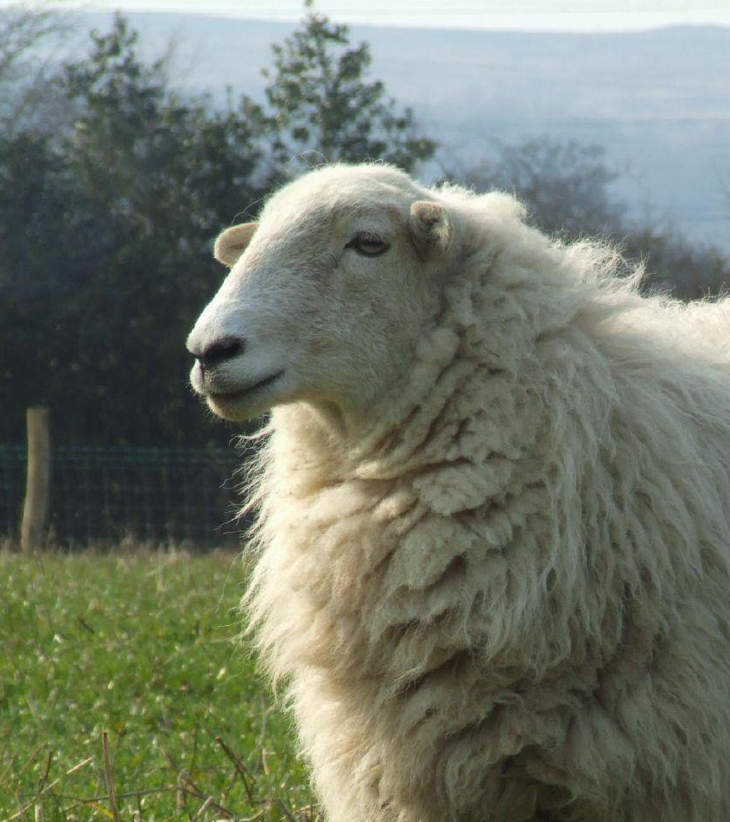
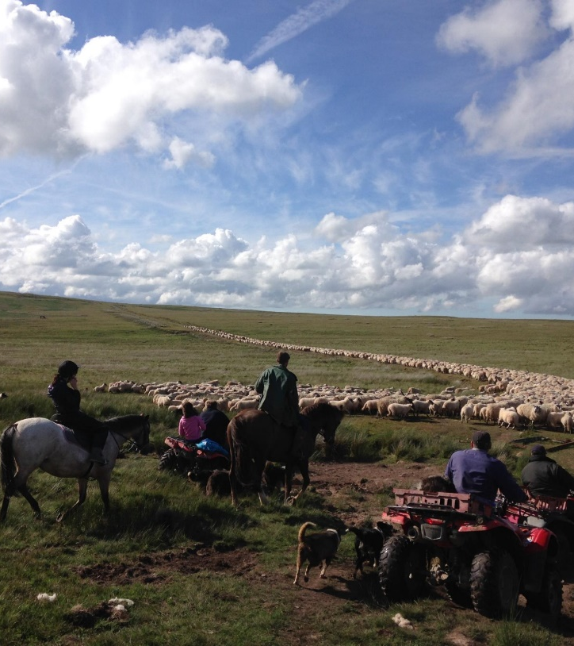
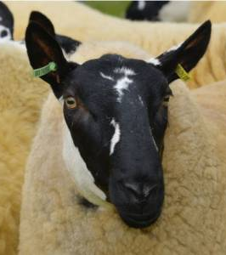

Slide 14
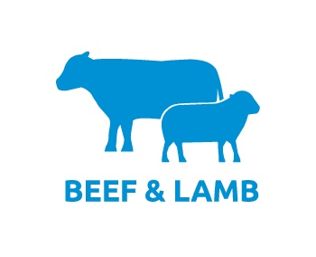

Slide 15
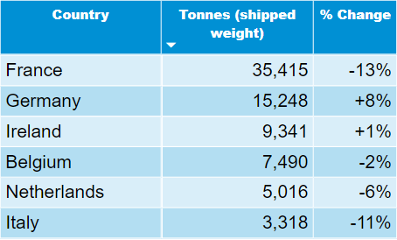
UK Export Volumes
YTD to Dec 2018 - Sheep Meat Exports Yr on Yr % change
YTD Total Volume: DOWN 8% at 82,569 tonnes shipped weight
Source: IHS Maritime & Trade, Global Trade Atlas ®. HMRC, Defra
Header
Header
Header
Content
Content
In 2018, UK sheep meat production down 10,800 tonnes cwe.
During the same period, UK exports in cwe down 7,500 tonnes.
Notes:
Exports have come under pressure for 2 reasons: a) high farmgate prices which have reduced competitiveness (GB price trended above the French price from Mid April will mid June when typically the GB price is 80% of the French price). 2) Production down therefore less product available.

Slide 16
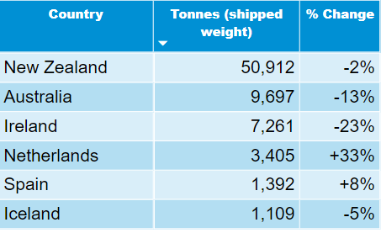
UK Import Volumes
YTD to Dec 2018 - Sheep Meat Imports Yr on Yr % change
YTD Total Volume: at 77,304 tonnes, down 4% on last year
Source: IHS Maritime & Trade, Global Trade Atlas ®. HMRC
Header
Header
Volume of EU imports DOWN
1% to 14,566 tonnes
Header
Content
Content
Volume of non-EU imports down 4%
at 62,738 tonnes
NZ & AUS directing more product into China and US.
Notes:
During July and August Australian lamb price broke 700c/kg then went through 800c/kg. Never been over 700c/kg. NZ and Aus price being driven by increased Global demand for Lamb.

Slide 17
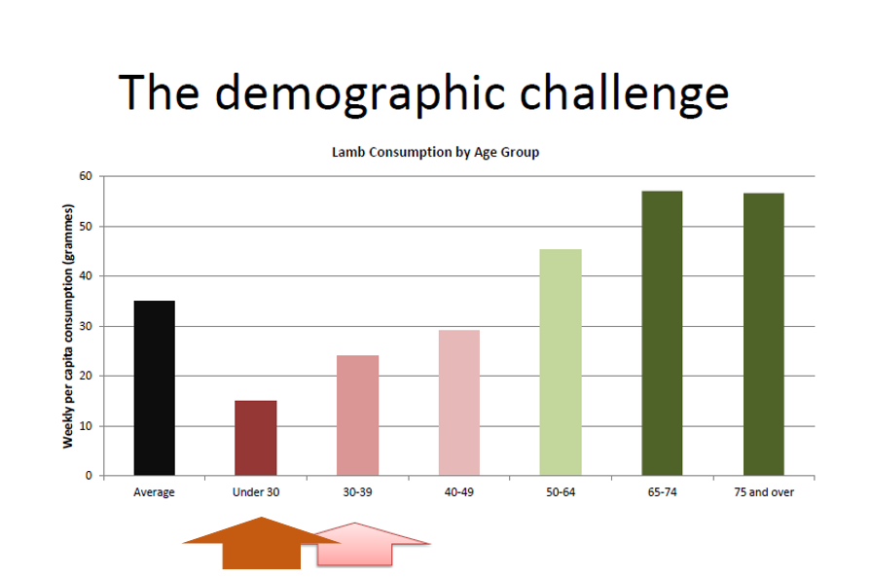
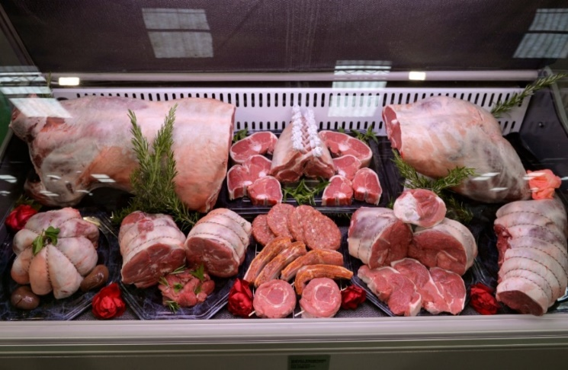
Challenges
Consumption of lamb by age group
Under 30s
30-39

Slide 18
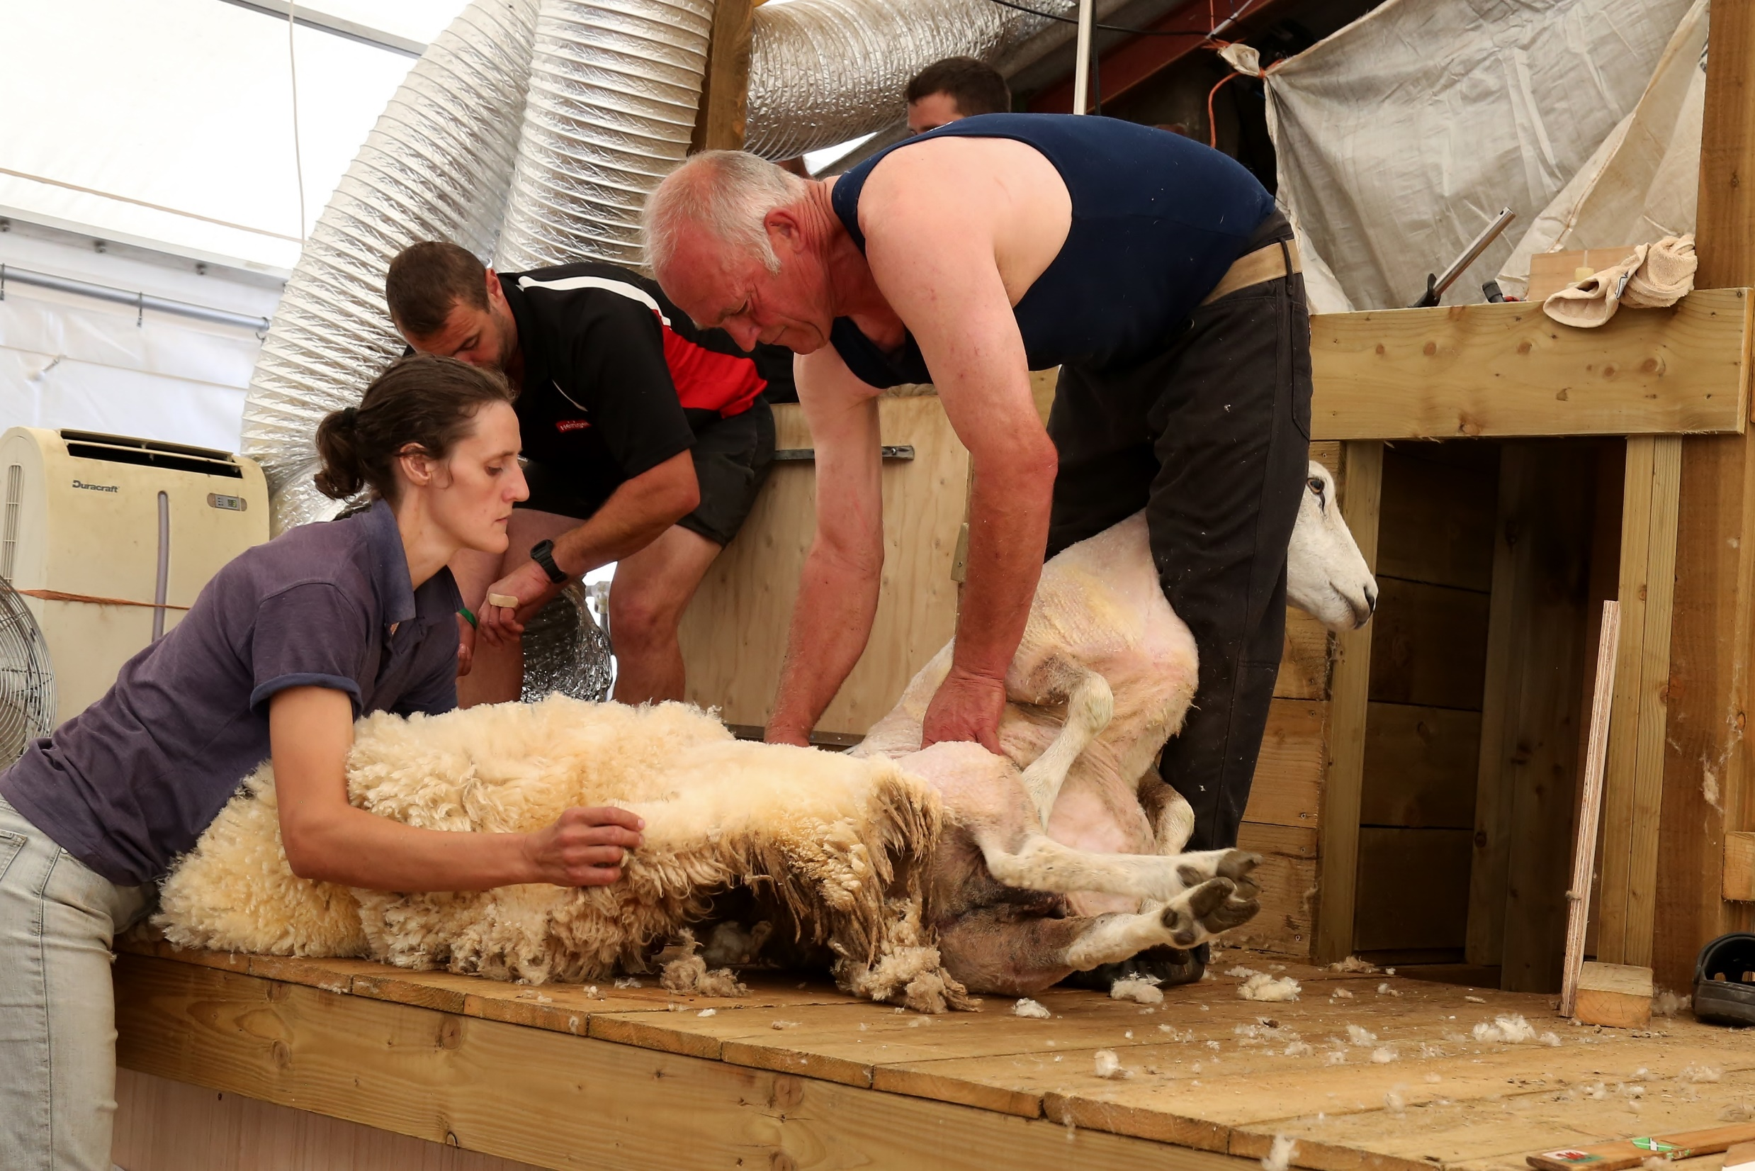
Global Sheep Breeders Conference - Canada

Slide 19
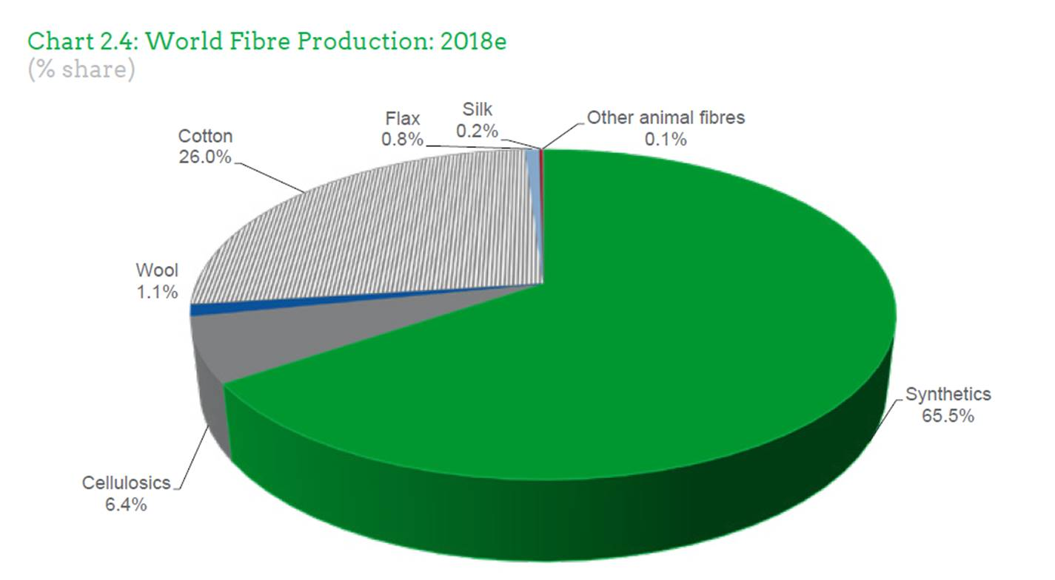
Global Fibre Production 2018

Slide 20
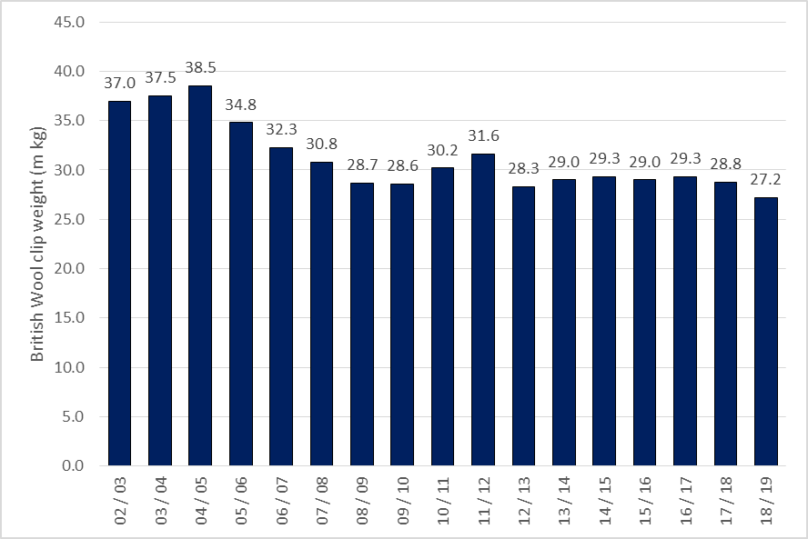
British Wool Clip Weight History

Slide 21
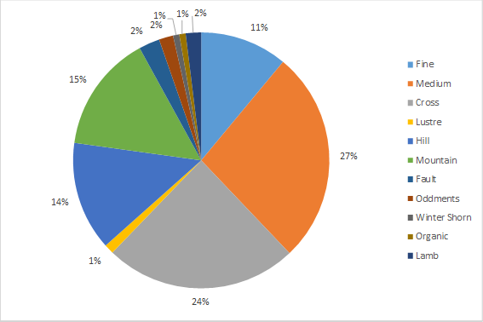
British Wool breakdown by type for the 2018 clip year

Slide 22
The current UK debate
At industry level
    Brexit and a return to own domestic agricultural and environmental policies
    Future trade development
In Society
    Climate change
    Natural resources
    Species loss
    Sustainable diets

Slide 23
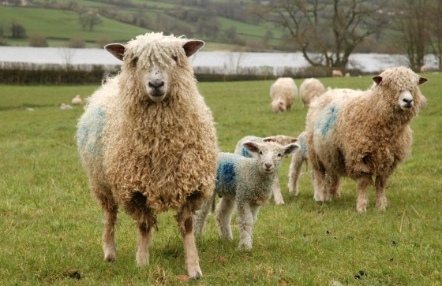
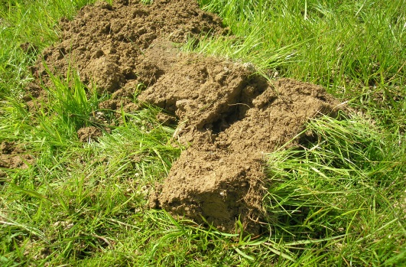

The challenge
placed on us
Increase our productivity
Protect and further improve our environment

Slide 24
No problems – only opportunities!!
Position sheep farming as the answer to societies concerns over planetary and human health
Ensure delivery and establish a new economic model that includes public goods
Increase enterprise productivity
Increase consumption amongst younger age ranges and develop new overseas markets

